Slide 1
Research agent
CAPSTONE PROJECT
Presented By : Chakka Satyasree
Student name : Chakka Satyasree
College Name & Department : Malla Reddy College of Engineering for Women - CSE

Slide 2
OUTLINE
Problem Statement
Technology used
Wow factor
End users
Result
Conclusion
Git-hub Link
Future scope
IBM Certifications

Slide 3
Problem Statement
Research Agent : The Challenge- A Research Agent is an AI system designed to assist with academic and scientific research tasks. It can autonomously search for literature, summarize papers, and organize references. Using natural language processing, it understands research questions and retrieves relevant information. The agent can generate reports, suggest hypotheses, and even draft sections of research papers. It saves time by automating repetitive tasks like citation management and data extraction. Research Agents enhance efficiency, accuracy, and innovation in both academic and industrial R&D.

Slide 4
Technology used
IBM cloud lite services
IBM Granite model

Slide 5
IBM cloud services used
IBM Cloud Watsonx AI Studio
IBM Cloud Watsonx AI runtime
IBM Cloud Agent Lab
IBM Granite foundation model

Slide 6
Wow factors
1.AI That Thinks Like a Researcher
Understands complex research questions just like a human expert
Uses IBM Granite for advanced language understanding & generation
2. Saves Months of Work in Minutes
Automates literature reviews, summarization, and citation formatting
Reduces 50–70% of manual research effort
3. End-to-End Research Support
From searching academic papers → Summarizing findings → Formatting citations → Drafting sections of research papers
4. Multi-Domain Expertise
Works for academic, industrial R&D, and educational purposes
Can adapt to multiple research fields instantly
5. Powered by IBM Cloud Lite Services
IBM Watson Discovery for intelligent search
IBM Watson NLU for semantic analysis
IBM Cloud Storage for secure research data management
6. Next-Generation Collaboration Tool
Makes research accessible for students, professors, and corporate researchers
Can be integrated with existing research management tools like Zotero or Mendeley
7. Scalable & Future-Ready
Can handle thousands of research documents in real time
Learns & improves continuously with new research data

Slide 7
End users
Academic Researchers & Professors
To speed up literature reviews, manage citations, and draft research papers.
PhD & Postgraduate Students
To find relevant papers, summarize findings, and structure their research work.
Undergraduate Students
To assist in preparing final-year projects and mini research reports.
Industry R&D Teams
For patent search, competitor research, and trend analysis.
Corporate Analysts & Data Scientists
To quickly analyze technical research and market reports.
Educational Institutions
As a tool for guiding students in research methodology and content creation.
Independent Researchers & Innovators
To explore new ideas and validate research hypotheses efficiently.

Slide 8
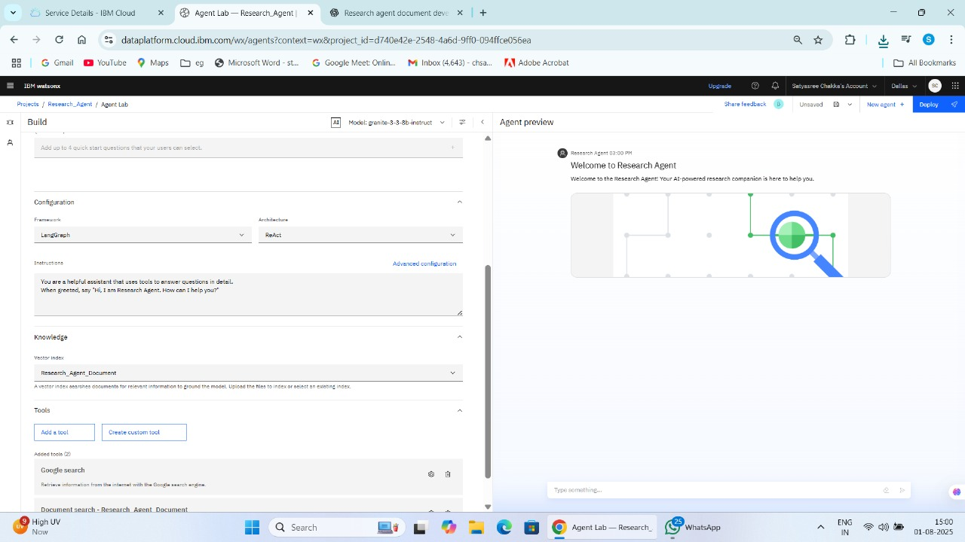
Results

Slide 9
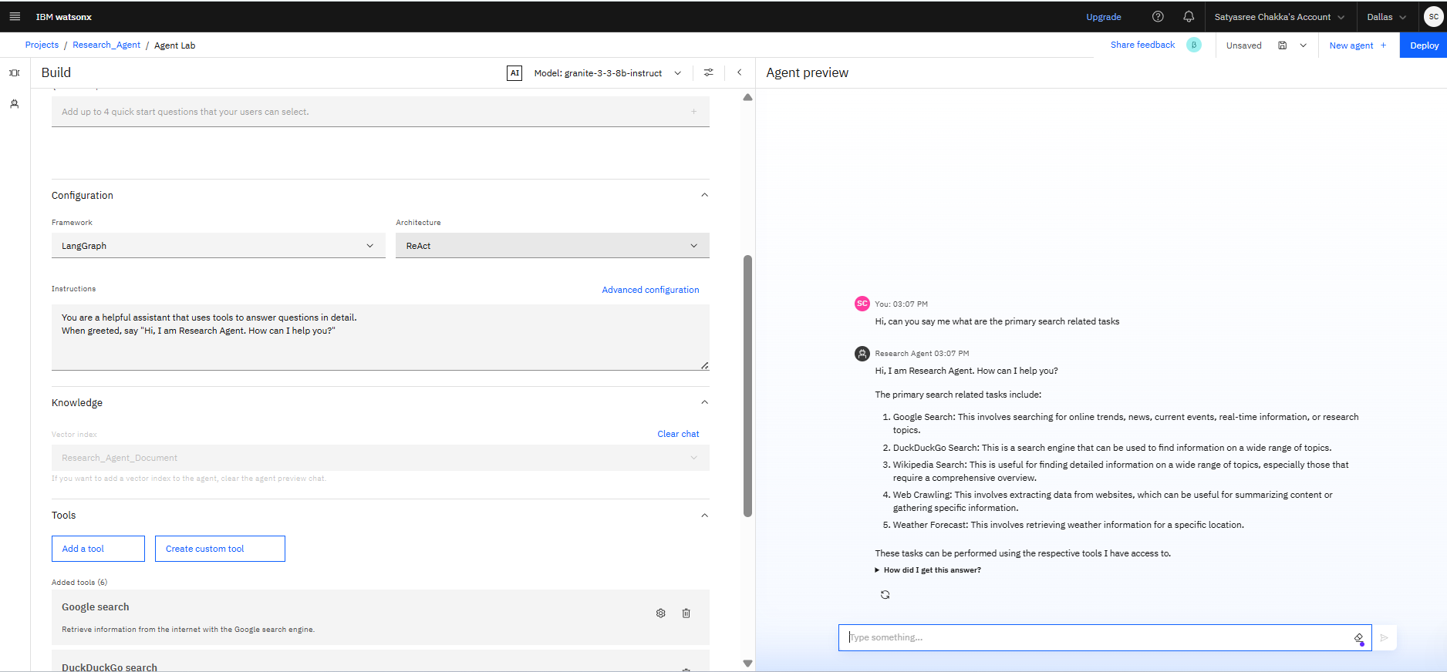
Results

Slide 10
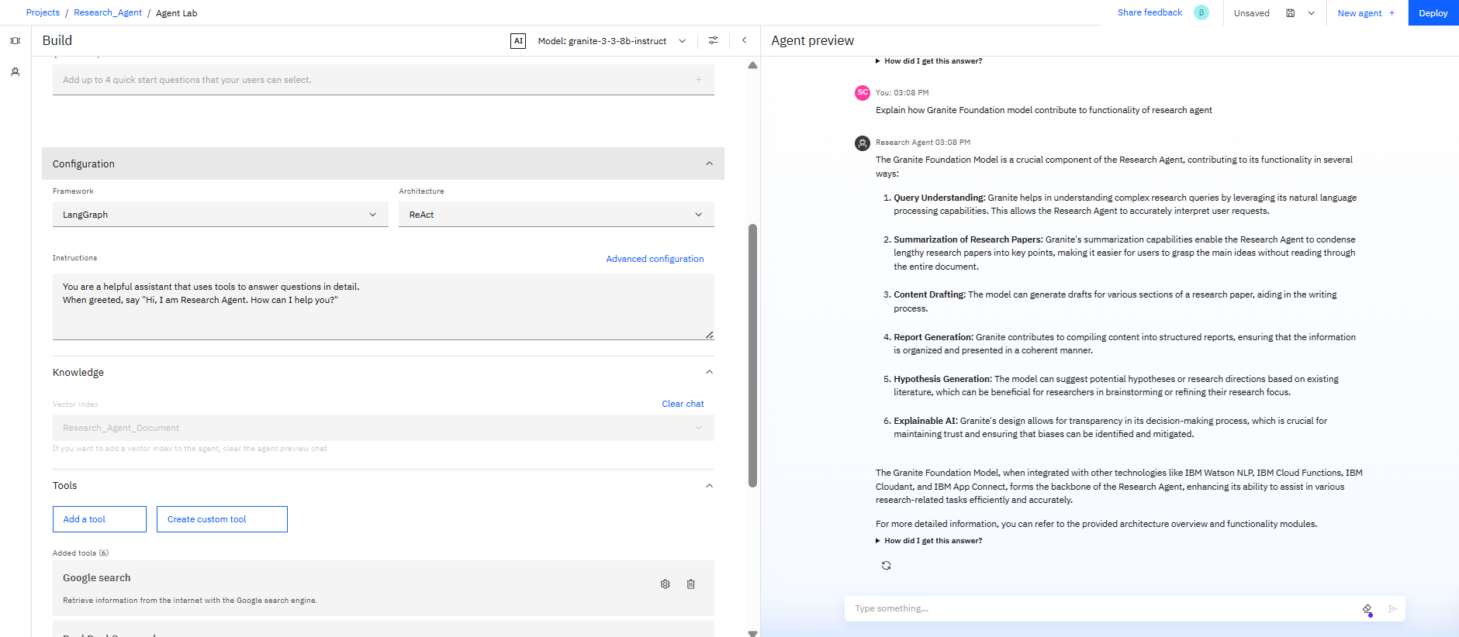
Results

Slide 11
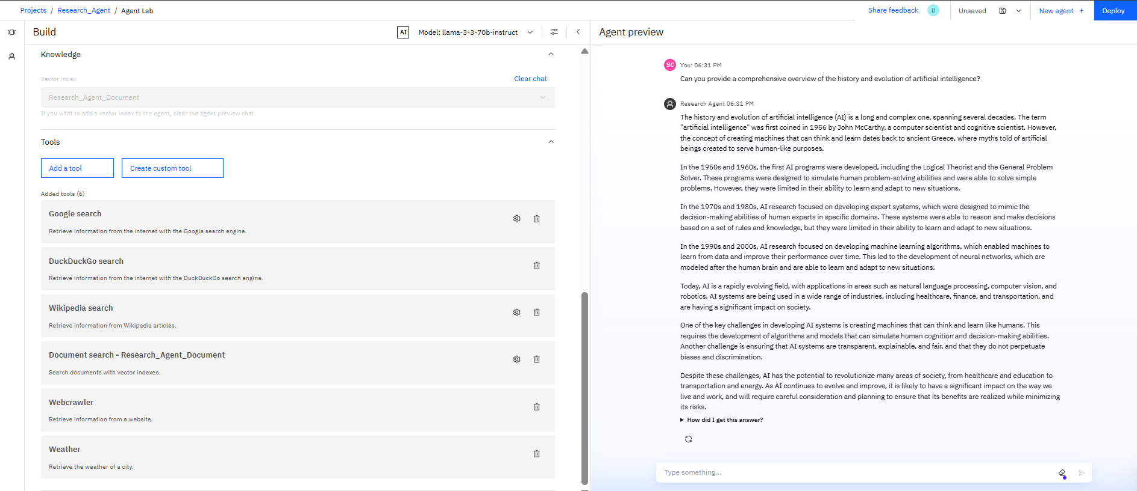
Results
Search : The History and Evolution of Artificial Intelligence
A Comprehensive Overview

Slide 12
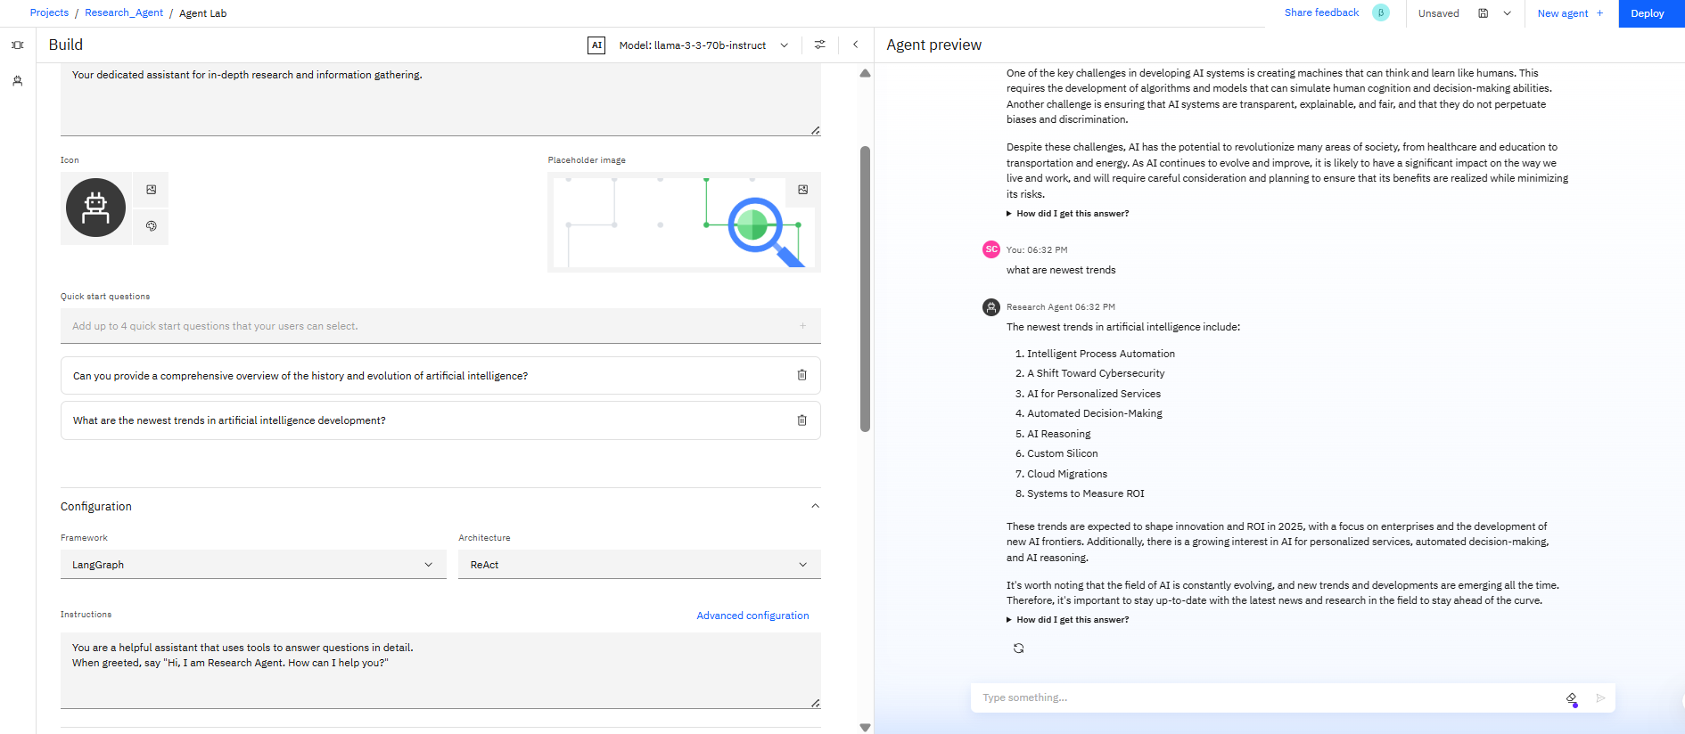
Results

Slide 13
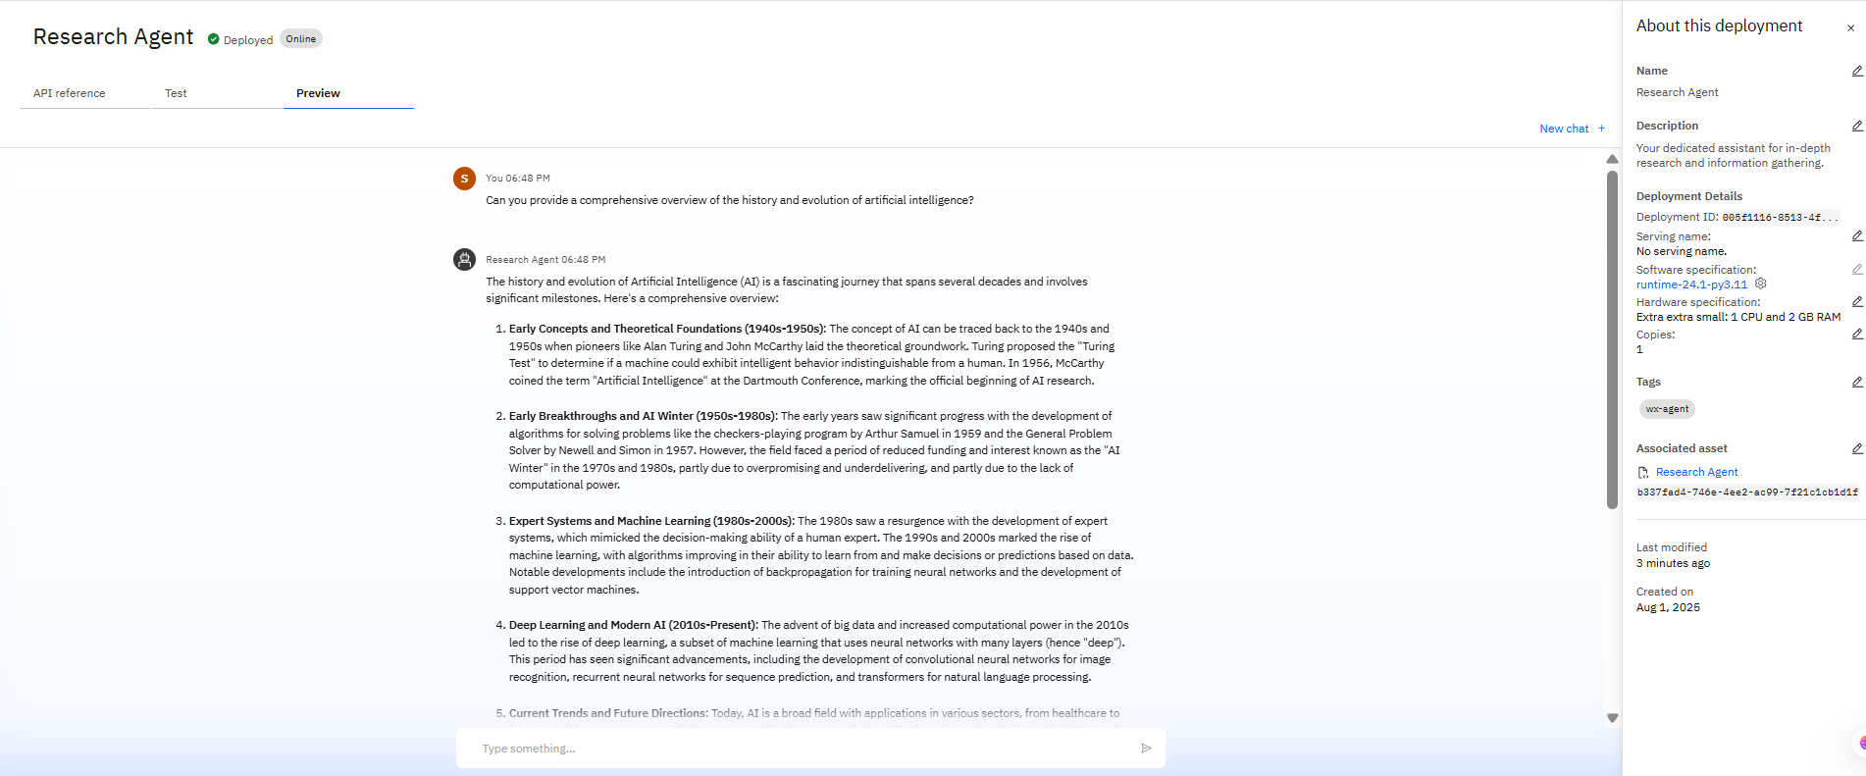
Results
Deployed AI Agent

Slide 14
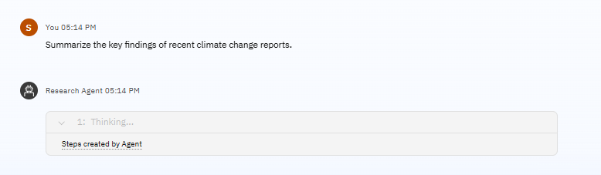
Results
Deployed AI Agent

Slide 15
Conclusion
The Research Agent is a transformative AI solution that redefines how academic and industrial research is conducted. By leveraging IBM Cloud Lite Services and IBM Granite, it automates tedious tasks like literature search, paper summarization, citation management, and research drafting — saving time, improving accuracy, and fostering innovation.
With its ability to adapt across multiple domains and provide end-to-end research assistance, the Research Agent stands as a future‑ready companion for researchers, students, and industry professionals alike. It is not just a tool — it’s a partner in discovery and knowledge creation.

Slide 16
Future scope
Integration with More Research Databases
Connect with Scopus, Web of Science, Springer, and other global academic sources for broader literature access.
Voice-Based Research Assistance
Enable voice commands for hands-free research queries and responses.
Multilingual Research Support
Search, summarize, and draft research content in multiple languages to support global researchers.
Real-Time Collaboration
Allow multiple researchers to work together on shared research projects inside the agent.
Advanced Data Visualization
Convert extracted research data into interactive graphs, charts, and dashboards.

Slide 17
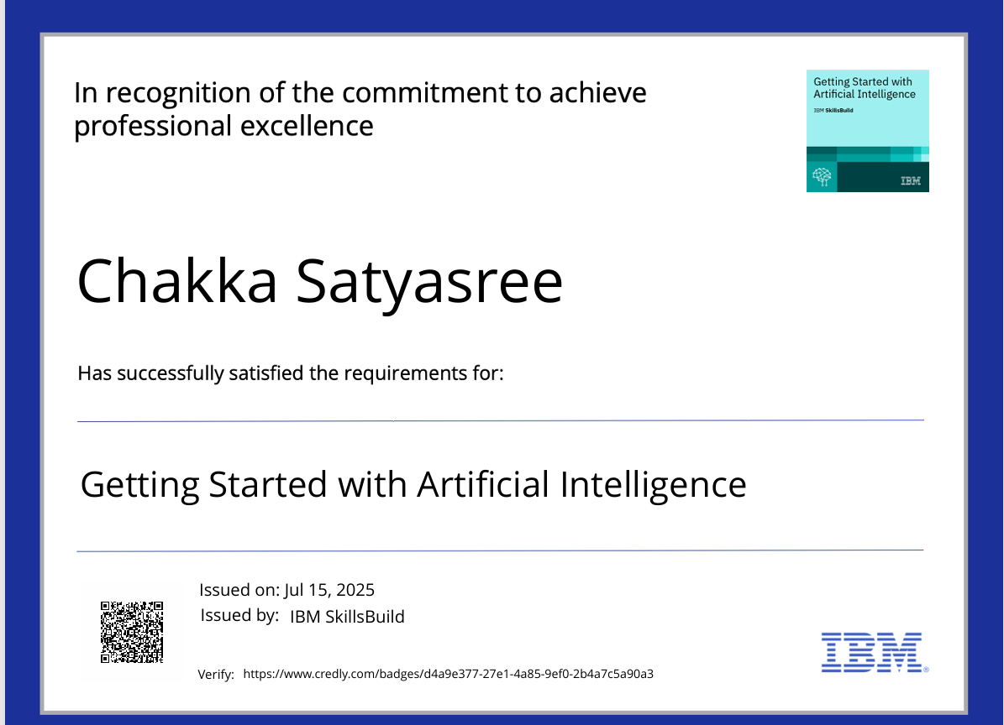
IBM Certifications
Getting Started with Artificial Intelligence Certification

Slide 18
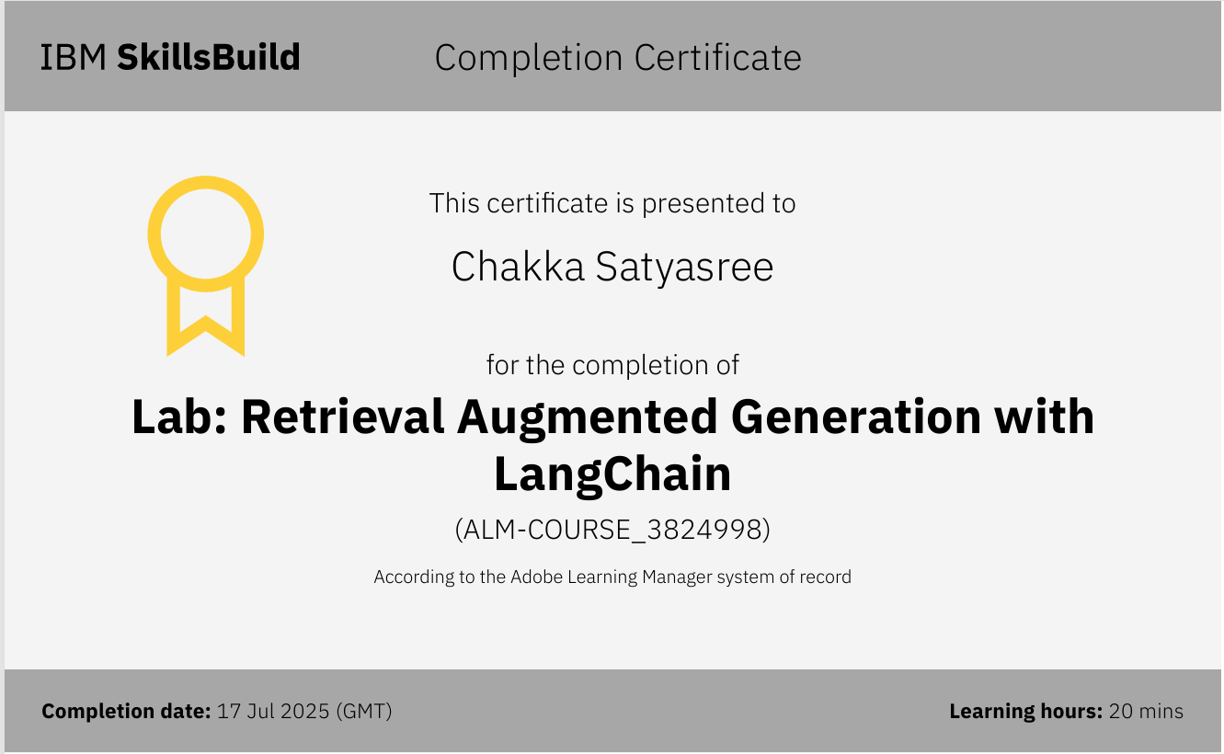
RAG Lab Certification

Slide 19
Git hub link : https://github.com/Chsatyasree3/Research-Agent

Slide 20
THANK YOU

